Slide 2
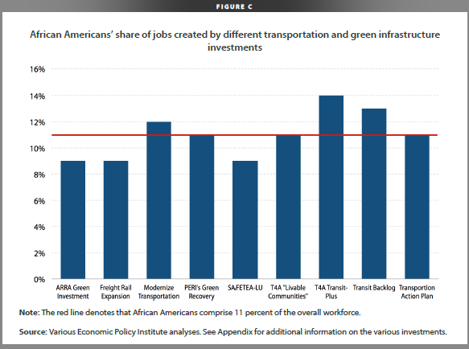

Slide 3
Transit jobs in high demand pay above
national median wages, provide good benefits
and career pathways/ladders opportunities
2013 Poverty threshold for a family of four (2 children) -- $23,624
Draft – Do Not Distribute
Notes:
The size of the bubbles in this chart indicates the total projected job openings in the next ten years. Same as the bar chart you saw a minute ago, transit and intercity bus drivers, bus mechanics, dispatchers and supervisors of operators will see the most job openings in transit. The two additional dimensions this chart shows are the national median annual wages and education, work experience and skills training requirements for entry into these top jobs.
The blue dotted line shows the average national median wage for all occupations at $34,750. The four top transit jobs all pay above this national average. For example, 50 percent of the bus operators are paid over $37k. At 75 and 90 percentiles, the wages are even higher. $49,000. $61,000. As entry level workers reach higher competence level and gain seniority, or move up the career ladder, their wages continue to progress.

