Slide 1
ADMINISTRATION SUPPORT
CAREER PATHWAYS SYSTEMS DEVELOPMENT
In April 2012, the U.S. Departments of Education, Labor, and Health and Human Services issued a joint commitment to…
“promote the use of career pathways approaches as a promising strategy to help adults acquire marketable skills and industry recognized credentials through better alignment of education, training and employment, and human and social services among public agencies and with employers.”

Slide 2
CAREER PATHWAYS DEFINITION
The U.S. Departments of Labor, Education, Health and Human Services have agreed that Career Pathways are:
“A series of connected education and training strategies and support services that enable individuals to secure industry relevant certification and obtain employment within an occupational area and to advance to higher levels of future education and employment in that area.”

Slide 3
CAREER PATHWAYS:
Help individuals pursue, regardless of their skills at entry, progress through and complete education and training needed to attain industry-recognized credentials and family-sustaining careers
Meet skill requirements of employers in high-demand industries and occupations.
Do this by aligning the education, workforce and social supports needed for credentials in high demand industries and occupations.

Slide 4
SIX KEY ELEMENTS FOR DEVELOPMENT OF CAREER PATHWAYS SYSTEMS
Notes:
Build Cross-Agency Partnerships & Clarify Roles
Identify Sector or Industry & Engage Employers
Design Programs
Identify Funding Needs & Sources
Align Policies & Programs
Measure System Change & Performance

Slide 5
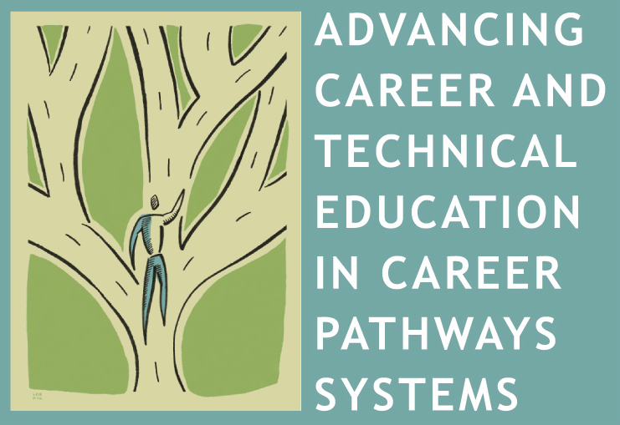
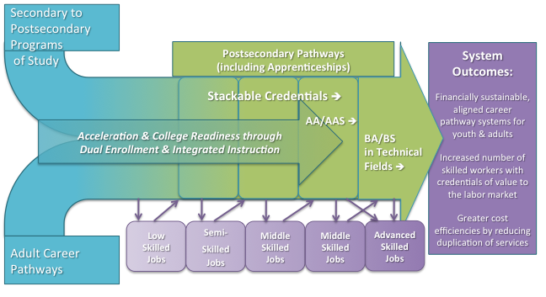
A DRAFT VISUAL INTERPRETATION OF COMPREHENSIVE CAREER PATHWAYS SYSTEMS

