Slide 1
An Up-to-Date Analysis of
Future Workforce Needs in Transit
Xinge Wang
Director of Research
September 2014

Slide 2
With 63 percent of workforce above age 45,
retirements will loom large in transit.
Source: TLC & JFF analysis based on BLS & Census 2014 industry and occupational employment. Data retrieved from EMSI in June 2014.
Draft – Do Not Distribute
Notes:
With 63% of the transit workforce above age 45, retirements will loom large in the future.
In a number of transit agencies, workers can retire with negotiated pension eligibility, such as thirty years of service or 62 years old. This means that some who were hired young can be eligible to retire as early as their late 40s.

Slide 3
Transit has the highest percentage of older
workers among all transportation sectors
Draft – Do Not Distribute
Notes:
With 63% over 45 years old, transit have the highest percentage of older workers facing retirement. Railroad is the second highest at 57%. Both are much higher than the national average of 46%.

Slide 4
Transit job openings in 10 years are estimated at
1.25 times its current employment
Draft – Do Not Distribute
Notes:
Transit job openings in 10 years are estimated at 1.25 times its current employment, the 2nd highest among all six transportation modes.
Transit will have 978,000 projected job openings in 10 years due to growth and separations; 2nd largest in transportation

Slide 5
Bus drivers, mechanics, dispatchers,
and first-line supervisors has
the highest long-term job demand in transit
Draft – Do Not Distribute
Notes:
The chart shows the total job openings due to growth, retirement, turnover and other exits in the next decade. Transit and intercity bus drivers is projected to have close to 200k jobs opening up. Bus mechanics, dispatchers, and first-line supervisors of operators also have high long-term job demand in transit.

Slide 6
Operations and maintenance jobs account for 95%
of the projected transit job openings
Draft – Do Not Distribute
Notes:
95 percent of the projected job openings in transit and ground passenger transportation will be created in operations and maintenance. As an overwhelming share of the transit workforce development dollars are being spent on white collar jobs,

Slide 7
Transit jobs in high demand pay above
national median wages, provide good benefits
and career pathways/ladders opportunities
Draft – Do Not Distribute
Notes:
The size of the bubbles in this chart indicates the total projected job openings in the next ten years. Same as the bar chart you saw a minute ago, transit and intercity bus drivers, bus mechanics, dispatchers and supervisors of operators will see the most job openings in transit. The two additional dimensions this chart shows are the national median annual wages and education, work experience and skills training requirements for entry into these top jobs.
The blue dotted line shows the average national median wage for all occupations at $34,750. The four top transit jobs all pay above this national average. For example, 50 percent of the bus operators are paid over $37k. At 75 and 90 percentiles, the wages are even higher. $49,000. $61,000. As entry level workers reach higher competence level and gain seniority, or move up the career ladder, their wages continue to progress.

Slide 8
Draft – Do Not Distribute
Notes:
This slide shows some sample career pathways and ladder in transit. You’ll find that the jobs with the highest demand are nicely situated in these ladders, with a lot of career advancement potentials. It is important to also note that even though transit rail occupations don’t seem to come up with the highest demand, the impact of retirement is just as large, if not larger, than the bus side.

Slide 9
Women continue to be underrepresented in transit,
especially in technical positions e.g. mechanics
Draft – Do Not Distribute
Notes:
In 2013, women comprised 47% of the workforce in the US. However, women continue to be highly underrepresented throughout the transportation industry.
Transit may have a larger share of women employees than other transportation modes, but compared with the national working population, that share is still very low. At the same time, female employment in transit is heavily skewed toward operations, bus operators in particular. Female representation in transit technical occupations – the non-traditional jobs continue to be extremely low.

Slide 10
African-Americans and Hispanics are
underrepresented in higher paid and skilled transportation jobs
Draft – Do Not Distribute
Notes:
This chart portrays distribution of employment in key transportation jobs by race and ethnicity. The bars toward the top show employment in jobs that generally pay higher wages and have higher skills requirements, aircraft pilots, highway maintenance workers, bus mechanics, aircraft mechanics; And those toward the bottom with lower wages and lower skill requirements, truck and bus drivers, laborers, vehicle cleaners. African Compared with the national average at the very bottom, American and Hispanics are underrepresented in those transportation jobs with better pay, with the exception of bus and truck mechanics, where the share of Latinos is the same 16% as national average. This indicates there is a lot of room for transportation career pathways and skills training programs targeting minority populations. At the same time when we are trying to lower the unemployment rate of blacks and Latinos and provide employment opportunities.

Slide 11
Projected annual job openings are 90% larger than related educational program completions across key transportation occupational groups
Draft – Do Not Distribute
Notes:
Preliminary analysis indicates that projected annual job openings are 90% larger than related educational program completions across key transportation occupational groups.
This highlights a gap that must be addressed to meet expected industry demand.

Slide 12
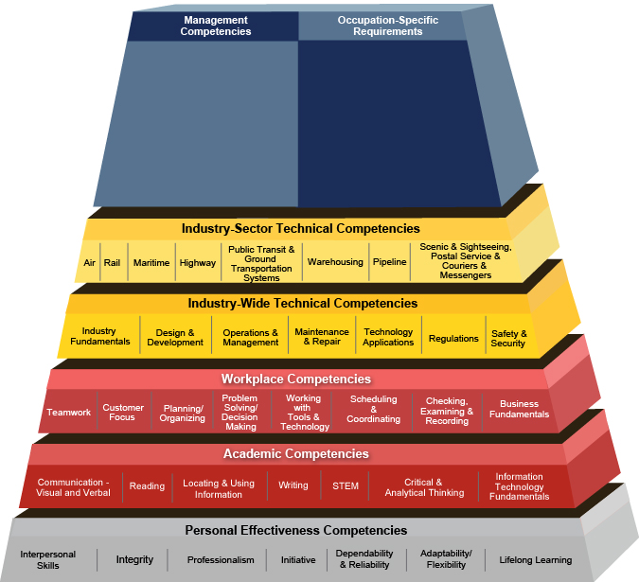
DOL Competency Model on
Transportation, Logistics & Warehousing

