Slide 1
Transit Bus Emissions
Control Systems
Day 3: DEF/DPF with SCR Emissions Control Systems

Slide 2
Today’s Learning Objectives
Explain the operation and major functions of UTA’s 2010 Emission control system
Explain why additional engine cooling capacity is needed to meet EPA 2010 regulations
Explain operation of active regeneration injectors, SCR, and DEF injection system
Diagnose and repair faults related to the DEF injection system
Use Cummins INSITE for analyzing and troubleshooting 2010 buses
Notes:
Detailed List:
Mod 6: Explain the operation and major functions and components for UTA’s 2010 emission control system. Explain why additional engine cooling capacity is needed to meet EPA 2010 regulations. Explain safe handling procedures for Diesel Exhaust Fluid (DEF). Identify and explain operation of VGT (on 2010 buses) Identify and explain operation of active regeneration injectors Identify and explain operation of differential pressure sensor (delta p) and NOx sensor Identify and explain operation of DEF supply module and DEF tank, and DEF hoses Identify and explain operation of decomposition reactor / tube (crossover pipe) and DEF dosing valve Identify and explain operation of SCR, inspect brackets and piping Inspect diesel exhaust fluid (DEF) injection system associated with SCR including injector, pump, dispenser, and DEF lines Explain purpose and process of performing a regen
Mod 7: Diagnose faults related to DEF injection system including injector, pump, dispenser and distribution lines. Diagnose, maintain and replace operation of differential pressure sensor and NOx sensor Diagnose, maintain and replace operation of DEF supply module Diagnose, maintain and replace DEF tank – including checking filtration, heater elements, pump and fluid level sensors Diagnose, maintain and replace DEF hoses Diagnose, maintain and replace operation of SCR Diagnose, maintain and replace operation of decomposition reactor – including checking clamps and seals when needed Diagnose, maintain and replace operation of dosing valve injector and active regeneration injectors Diagnose, maintain and replace operation of VGT – including checking leaks, pipes and clamps Interpreting information and responding to engine struggling to complete a regen Developing skills in interpreting information provided by software Identify when a system is vulnerable to coding (proactive diagnosis) Use of Cummins Quickserve for Diagnosing 2010 buses Use of JD Edwards to obtain additional maintenance information Aftertreatment dosing injector cleaning

Slide 3
DEF w/SCR Emissions Control Systems
This approach is installed on 2010 coaches with Cummins engines at UTA
We will walkthrough documentation from Quickserve for a 2010 ISB Engine (#73087097)

Slide 4
DEF w/ SCR Emissions Control Systems Operations

Slide 5
2010 ISB Engine Diagram – Front View
Alternator mounting
Coolant outlet connection / thermostat housing
Fan hub
EGR connection tube
EGR valve
Oil pressure switch
Engine speed/position sensor (camshaft)
Engine speed/position sensor (crankshaft)
Vibration damper (viscous)
Front gear cover
Water pump
Refrigerant compressor mounting location
Automatic belt tensioner
Turbocharger compressor inlet
Turbocharger compressor outlet
Source: Cummins Quickserve
Notes:
Emphasize location of sensors. Explain operation of delta p and NOx sensors. Point out common rail fuel system and discuss safety concerns.

Slide 6
2010 ISB Engine Diagram – Left Side View
Fuel filter
Air compressor coolant supply
Service diagnostic test connection for fuel system tests
Fuel drain tube (fuel rail pressure relief valve)
Rear engine lifting bracket
Crankcase ventilation tube
Air compressor coolant return
Fuel filter return line
Fuel filter supply line
Fuel pump actuator
High-pressure fuel pump
Flywheel housing
Gear pump fuel pump
High pressure fuel supply to rail
Air compressor
Main lubricating oil gallery port
Lubricating oil pan
Lubricating oil drain plug
Lubricating oil heater mounting location
Lubricating oil heater mounting location
Crankshaft speed indicator ring
Lubricating oil level gauge (dipstick)
Electronic Control Module (ECM)
Intake air inlet
EGR valve
EGR differential pressure sensor
Source: Cummins Quickserve
Notes:
Emphasize location of sensors. Explain operation of delta p and NOx sensors. Point out common rail fuel system and discuss safety concerns.

Slide 7
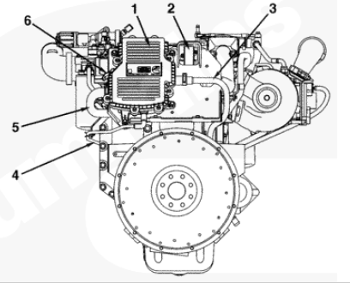
2010 ISB Engine Diagram – Rear Views
Cylinder head fuel drain (injector) connection
Exhaust outlet connection
Flywheel – manual transmissions
Flexplate – automatic transmissions (not shown)
Flywheel housing
Air compressor coolant return tube.
With external flywheel housing mounted breather system (picture at left):
Crankcase ventilation filter housing
Breather connection tube (rocker lever cover to rear gear housing)
Crankcase breather outlet tube
Crankcase breather oil drain tube
Crankcase breather tube (flywheel housing to crankcase ventilation filter housing
Crankcase pressure sensor
Source: Cummins Quickserve
Notes:
Emphasize location of sensors. Explain operation of delta p and NOx sensors. Point out common rail fuel system and discuss safety concerns.

Slide 8
2010 ISB Engine Diagram – Right side view
EGR cooler
Variable geometry turbocharger coolant return tube
Turbocharger compressor outlet
EGR cooler coolant return tube
Front engine lifting bracket
Exhaust pressure sensor tube
Oil pressure regulator
Oil filter head / Oil cooler
Water inlet connection
Oil filter
Coolant heater port
Air compressor coolant return tube
Variable geometry turbocharger oil supply tube
NOx sensor mounted on block; sensor installed in exhaust plumbing at turbocharger outlet
Variable geometry turbocharger coolant supply tube
Variable geometry turbocharger oil drain tube
Starting motor
Gear housing (rear)
Service access / Barring point
Variable geometry turbocharger actuator
Variable geometry turbocharger (VGT)
Exhaust manifold
EGR cooler coolant supply tube
Source: Cummins Quickserve
Notes:
Emphasize location of sensors. Explain operation of delta p and NOx sensors. Point out common rail fuel system and discuss safety concerns.

Slide 9
2010 ISB Engine Diagram – Top view
EGR cooler
Crankcase ventilation filter cover*
Turbocharger speed sensor
EGR cooler coolant supply tube
Crankcase pressure sensor**
Rocker lever cover
Injector harness pass-through connector (1 of 2)
Fuel rail pressure sensor
Fuel injector supply lines (high pressure – 6 total)
Intake air manifold temperature/pressure sensor
Fuel rail
Crankcase breather oil drain tube (1 of 2)
Intake air heater positive terminal
Injector harness pass-through connector (2 of 2)
Fuel pressure relief valve
Crankcase breather oil drain tube (2 of 2)
EGR temperature sensor
Intake air heater (internal to intake manifold)
Oil fill (rocker lever cover)
Coolant temperature sensor
De-aeration port (to OEM coolant top tank)
Exhaust pressure sensor
* On engines equipped with an externally mounted breather, the crankcase ventilation filter is located at the rear of the engine.
** On engines equipped with an externally mounted breather, the crankcase pressure sensor is located in the crankcase ventilation filter housing at the rear of the engine
Source: Cummins Quickserve
Notes:
Emphasize location of sensors. Explain operation of delta p and NOx sensors. Point out common rail fuel system and discuss safety concerns.

Slide 10
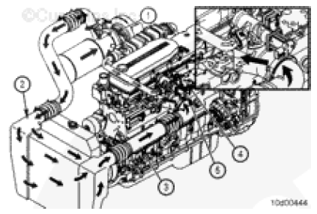
2010 Cummins ISB Air Intake Overview
On an engine with EGR, the air intake system and exhaust system components work together to provide the correct amount of intake charge flow into the engine. The major components of the intake system are:
Turbocharger
Charge Air Cooler (CAC)
Air Intake Connection
Air Intake Manifold / Cold Starting Aid
EGR Valve
1
2
4
5
3
Source: Cummins Quickserve
Notes:
Present the overall picture.
Transition to next slide: “Let’s take a closer look at each of these major components of the intake system.”

Slide 11
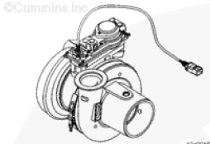
2010 Cummins ISB Turbocharger Operation (1)
The turbocharger in the 2010 Cummins is a variable geometry turbocharger (VGT). It includes:
A serviceable actuator mounted to the bearing housing of the turbocharger
A speed sensor in the bearing housing to monitor operation
Water cooled bearing housings (in addition to oil lubrication
Source: Cummins Quickserve
Notes:
Discuss:
Differences between Cummins and Detroit Turbocharger
Uniqueness of VGT design
Note: this is same turbocharger as on 07/09 Cummins models

Slide 12
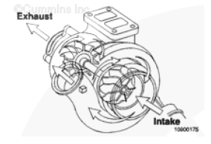
2010 Cummins ISB Turbocharger Operation (2)
Turbocharger uses exhaust gas energy from the engine to turn the turbine wheel
Turbine wheel drives the compressor wheel through a common shaft
Impellers on the compressor wheel draw intake air through the air filter and inlet plumbing into the turbocharger compressor housing
Air is then pressurized by the compressor wheel before being delivered to charge air cooler
Source: Cummins Quickserve
Notes:
Discuss:
Differences between Cummins and Detroit Turbocharger
Uniqueness of VGT design
Note: this is same turbocharger as on 07/09 Cummins models

Slide 13
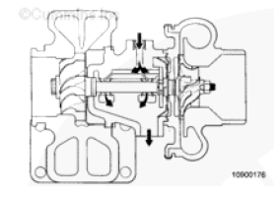
2010 Cummins ISB Turbocharger Operation (3)
The turbine, compressor wheel, and shaft are supported by two rotating bearings in the bearing housing. Passages in the bearing housing direct filtered, pressurized engine oil to the shaft bearing and thrust bearings. The oil is used to lubricate and cool the rotating components. Oil then drains from the bearing housing to the engine sump, through the oil drain line.
An adequate supply of good, filtered oil is very important to the life of the turbocharger. Make sure a high quality oil is used and the oil and the oil filter are changed in accordance with the maintenance recommendations.
Source: Cummins Quickserve
Notes:
Discussion points:
Note: Quickserve has additional sections on turbocharger bearings, bearing housing, and lubrication of the turbocharger which are not included in the power point. There are also several sections on troubleshooting and servicing turbochargers, and interpreting turbocharger noises
The uniqueness of the VGT turbocharger is explained by this slide.

Slide 14
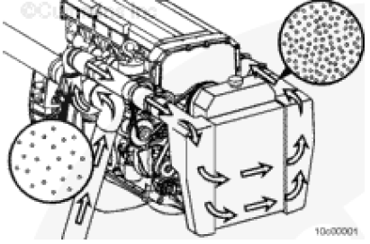
2010 Cummins ISB Charge Air Cooler (CAC)
Chassis mounted charge air coolers improve engine performance and reduce emissions
The system uses large diameter piping to transfer the air from the turbocharger to the CAC, then returns the air from the CAC to the intake manifold
Air compressed by the turbocharger increases in temperature, this air is passed through the CAC, which cools the air.
The cooler air is more dense, so more air can be compressed into the cylinder, yielding a greater combustion efficiency.
Source: Cummins Quickserve
Notes:
Same as 2009 ISL documentation

Slide 15
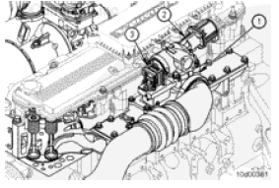
2010 Cummins ISB Air Intake Connection
The air intake connection (1) is a critical piece in combining the EGR flow and the fresh intake air.
EGR valve (2) is mounted on top of the air intake connection.
The amount of EGR flow entering the air intake connection is determined by readings from the delta p sensor (3)
The air intake connection is also the air intake source for engines with turbochargers. An air compressor inlet tube connects the air compressor to the air intake connection
Source: Cummins Quickserve
Notes:
This wasn’t in the Quickserve documentation for 2010, copied over from 2009 ISL … is it still valid?
Ask question: What is the purpose of the EGR valve? A: controls the amount of EGR flow into the air intake connection

Slide 16
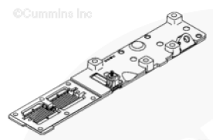
2010 Cummins ISB Air Intake Manifold / Cold Starting Aid
The air intake manifold with integral cold starting aid covers the intake portion of the cylinder head.
The cold starting aid is used to pre-heat the intake air under cold ambient conditions
The ECM controls the operation of the intake air heater by controlling a single solenoid which provides power for the heater when commanded
Source: Cummins Quickserve
Notes:
Discuss:

Slide 17
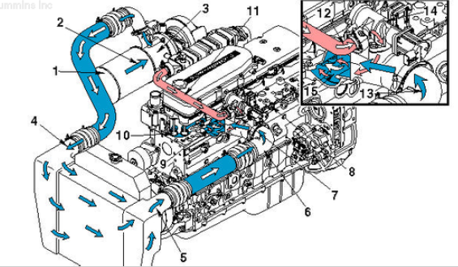
2010 Cummins ISB Air Intake Flow and Overall Operation
Air Intake Flow
Air cleaner
Turbocharger compressor inlet
Turbocharger compressor outlet
Charge air cooler inlet
Charge air cooler outlet
Air intake connection
Intake manifold
Intake port
Intake valves
EGR connection tube
EGR cooled exhaust gases
Charge air cooled intake air
EGR valve
Air mixture to combustion cylinder
Source: Cummins Quickserve
Notes:
Discussion point/starter: Now that we have looked at the main individual intake components, lets see how they work together …

Slide 18
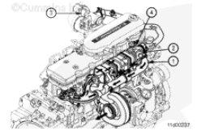
2010 Cummins ISB Exhaust System Overview
On an engine with EGR, the air intake system and exhaust system components work together to provide the correct amount of intake charge flow into the engine. The major components of the exhaust system are:
Exhaust manifold and seal
EGR cooler
EGR valve
Exhaust pressure sensor and mounting
…we will also look at the main aftertreatment components of the exhaust system
Source: Cummins Quickserve

Slide 19
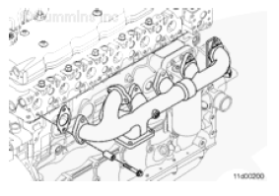
2010 Cummins ISB Exhaust Manifold and Seal
The exhaust manifold and seal is a two-piece design with a sealed slip-joint to allow for thermal expansion.
The exhaust manifold has an additional port (1) that connects to the EGR cooler inlet.
1
2
Source: Cummins Quickserve
Notes:
Note for different engines: depending on the application, the exhaust manifold used can vary in order to locate the turbocharger in various positions, as required by the application.

Slide 20
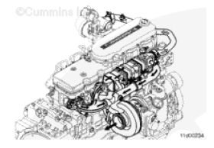
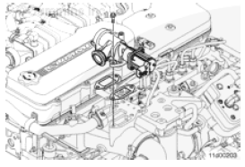
2010 Cummins ISB EGR Cooler and EGR Valve
The EGR cooler cools the exhaust gases flowing to the EGR valve. The EGR cooler is mounted above the exhaust manifold and is supported by the EGR cooler mounting bracket attached to the cylinder head.
The EGR cooler has a coolant vent near the exhaust outlet of the EGR cooler. This vent prevents air from being trapped in the cooler during coolant filling and engine operation by continuously flowing coolant to the top tank of the vehicle cooling system
Because the EGR valve is mounted on top of the air intake connection. The EGR valve is an electric motor-driven valve that is controlled by the engine ECM. The EGR valve uses a dual poppet valve to control the EGR flow into the air intake connection. The EGR valve is not a serviceable part.
Source: Cummins Quickserve
Notes:
Before showing paragraph 2, ask class is the EGR cooler is under the same or different exhaust temp and pressure as the exhaust manifold, and ask class to explain why.

Slide 21
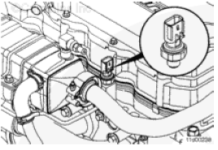
2010 Cummins ISB Exhaust Pressure Sensor and Mounting
Exhaust pressure in the exhaust manifold, is measured by an exhaust pressure sensor. What two things does the pressure in the exhaust manifold determine?
In order to maximize longevity, the sensor does NOT mount directly in the exhaust manifold.
The exhaust pressure sensor is located in a mounting pedestal attached to the cylinder head (shown in picture).
Source: Cummins Quickserve
Notes:
Ask before showing paragraph: What is determined by the exhaust pressure in the exhaust manifold?
Answer to question: the position of the variable geometry turbocharger and the EGR valve,.

Slide 22
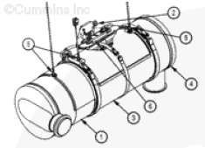
2010 Cummins ISB Exhaust Aftertreatment Components
The aftertreatment system is used to reduce particulate emissions and is composed of six main components:
Aftertreatment inlet and DOC
Aftertreatment DPF differential pressure sensor
Aftertreatment DPF
Aftertreatment outlet
Aftertreatment exhaust gas temperature sensors
Aftertreatment DPF temperature sensor interface module
2
5
5
4
6
3
1
Source: Cummins Quickserve
Notes:
Note: see different DOC location compared to 07 and 09s.

Slide 23
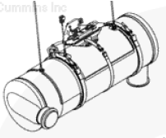
2010 Cummins ISB Passive Regeneration
Passive regeneration occurs when the exhaust temperatures are naturally high enough to oxidize the soot collected in the aftertreatment diesel particulate filter faster than the soot is collected.
Passive regeneration typically occurs when the temperature of the aftertreatment diesel particulate filter is above 316 C (600F). This occurs during highway driving or when driving with heavy loads.
Since passive regeneration occurs naturally, it is considered to be normal engine operation. No fuel is added to the exhaust stream during passive regeneration
Source: Cummins Quickserve

Slide 24
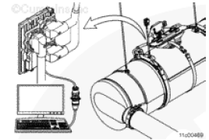
2010 Cummins ISB Active Regeneration
Active regeneration occurs when the exhaust temperatures are not naturally high enough to oxidize the soot collected in the aftertreatment diesel particulate filter faster than it is collected.
Active regeneration requires assistance from the engine in order to increase the exhaust temperature. This is typically done by injecting a small amount of diesel fuel into the exhaust stream (called aftertreatment injection) which is then oxidized by the aftertreatment DCO. The oxidation of this additional fuel creates the heat needed to regenerate the aftertreatment DPF.
For active regeneration to occur, the ECM must detect that the aftertreatment diesel particulate filter restriction has reached a specified limit. Once this limit is reached, the engine will alter its operation in order to create exhaust temperatures high enough to actively regenerate the aftertreatment DPF.
Source: Cummins Quickserve

Slide 25
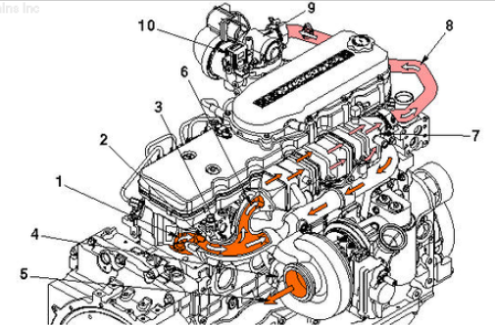
2010 Cummins ISB Exhaust System Flow and Overall Operation
Exhaust System Flow (1)
Exhaust valves
Exhaust port
Exhaust manifold
Turbocharger
Turbocharger exhaust outlet
Exhaust inlet to EGR valve and cooler
EGR cooler
Cooled exhaust outlet to EGR valve
EGR valve
EGR valve differential pressure sensor
Source: Cummins Quickserve
Notes:
This shows the flow of through on engine exhaust system components ….
Review the role of the charge air cooler, exhaust manifold and seal, EGR valve and EGR cooler, exhaust pressure sensor and mounting.

Slide 26
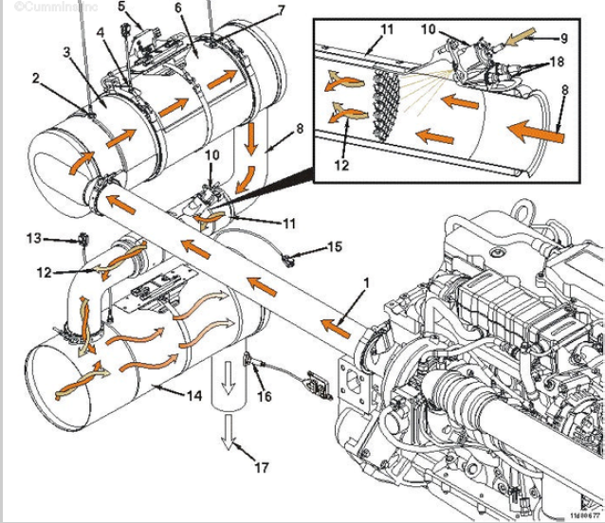
2010 Cummins ISB Exhaust System Flow and Overall Operation
Exhaust System Flow (2)
Exhaust gas flow from turbocharger
DOC intake temperature sensor
DOC
DPF intake temperature sensor
DPF pressure sensor
DPF
DPF outlet temperature sensor
Exhaust gas flow from the DPF
DEF supply from the aftertreatment DEF dosing valve
DEF dosing valve
Aftertreatment decomposition reactor
Exhaust gas and DEF mixture
SCR intake temperature sensor
SCR catalyst
SCR outlet temperature sensor
Aftertreatment outlet NOx sensor
Exhaust flow exiting aftertreatment system
Coolant supply and return for aftertreatment DEF dosing valve
Source: Cummins Quickserve
Notes:
… and this continues with flow through the aftertreatment components
Review role of aftertreatment. Discuss flow of exhaust through DPF and DOC, and DEF and SCR. Discuss role of active regeneration injectors (replacing the dosing valve injectors from the 07/09s) Discuss flow from dosing valves and intake to the SCR.

Slide 27
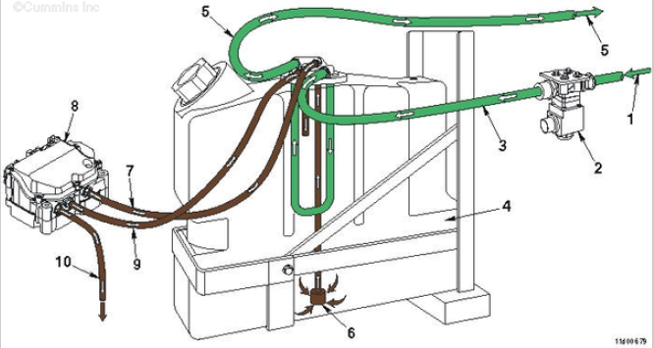
2010 Cummins ISB Exhaust System Flow and Overall Operation
Exhaust System Flow (3)
Coolant flow from engine to aftertreatment DEF tank coolant valve
DEF tank coolant valve
Coolant flow to DEF tank (only when DEF tank coolant valve is open
DEF tank
Coolant return to engine
DEF flow to DEF dosing tank
DEF flow to DEF dosing unit
DEF dosing unit
DEF return to DEF tank
DEF flow to DEF dosing valve
Source: Cummins Quickserve
Notes:
… and this continues with flow through the aftertreatment components

Slide 28
Notes on Other Engines
There are not yet any Detroit Diesels at UTA with this technology
There are also other similar Cummins engines using this system, this model is used as a representative sample
Notes:
Depending on location of students in class, adjust time spent to represent the engines they have the most of.

Slide 29
DEF w/ SCR Emissions Control Systems Service

Slide 30
Working with DEF
Q. Should I be concerned about handling DEF?
No. DEF is a nontoxic, nonpolluting, non-hazardous and nonflammable solution. It is stable, colorless, and meets accepted international standards for purity and composition. DEF is safe to handle and store and poses no serious risk to humans, animals, equipment or the environment when handled properly.
Q. What should I do if I spill DEF?
A. If DEF is spilled, contain the spilled liquid and absorb it with an inert, non-combustible absorbent material, such as sand. Shovel the material into a suitable container for disposal. Spills into a drain should be avoided. If spilled into a drain, flush thoroughly with water. For significant quantities, contact local authorities for proper disposal procedures. If DEF is spilled on your vehicle, rinse with water.

Slide 31
Working with DEF
Q. What happens if I ingest DEF?
DEF should never be ingested. If it is ingested, do not induce vomiting. A physician should be consulted if you begin experience any symptoms.
Q. What happens if I inhale DEF?
While pumping DEF will not cause significant exposure, inhalation may occur if exposed to DEF in a closed area and/ of if DEF is misted into the air. Under normal conditions of use, harmful effects are not expected. If you inhale DEF, you should move to an area with fresh air and obtain medical attention if symptoms, such as irritation to nose and throat, develop or persist.
Review MSDS sheet from Cummins for additional information.
Notes:
MSDS sheet will be placed in technician’s guide.

Slide 32
DEF w/ SCR Service
Process for servicing DEF supply module, DEF tank and hoses, cleaning DEF nozzle
Using the DEF flow tester
Removing fluid lines
Servicing decomposition reactor and DEF dosing valve
Servicing SCR and related brackets and piping
Servicing DEF injection system (injector, pump, dispenser, supply lines)
Notes:
Lead a general discussion

Slide 33
Exhaust, Intake and Aftertreatment Service Instructions
The student guide contains 2010 ISB service manual instructions for:
Dry exhaust manifold
Exhaust restriction
EGR cooler, valve and connection tubes
Exhaust gas pressure sensor tube
EGR cooler coolant lines
Aftertreatment SCR Catalyst
Aftertreatment DPF
DPF Differential pressure sensor tubes
Aftertreatment DOC
Aftertreatment system
Exhaust system diagnostics
Aftertreatment DEF Fluid Controller
Aftertreatment DEF Fluid dosing unit / Dosing valve override test
Aftertreatment DEF Fluid dosing valve
Aftertreatment DEF Fluid dosing unit filter
Aftertreatment decomposition tube
Aftertreatment outlet
Air in DEF
Aftertreatment DEF Controller Calibration code
Aftertreatment DEF system leak test
Air inlet connection
Air intake manifold
Air leaks, Air Intake and Exhaust systems
Charge Air Cooler
Air intake restriction
Turbocharger
Turbocharger coolant hoses
Turbocharger oil drain line
Turbocharger oil supply line
Intake manifold pressure
Air intake connection
Turbocharger compressor outlet connection
VGT turbocharger actuator
Air intake system diagnostics
Which of these have you had trouble with?
Notes:
Which of these should be explored more in depth? Can the students lead the way here, or do we want to pick certain procedures to discuss?
Should we zoom in on SCR and DEF items that are new to 2010?
Listed in lesson plan:
Process for servicing DEF supply module, DEF tank and hoses, cleaning DEF nozzle
Using the DEF flow tester
Removing fluid lines
Servicing decomposition reactor and DEF dosing valve
Servicing SCR and related brackets and piping
Servicing DEF injection system (injector, pump, dispenser, supply lines)

Slide 34
DOC w/ DPF Emissions Control Systems Troubleshooting

Slide 35
DEF w/ SCR Problems
Aftertreatment DPF – excessive ash cleaning
Intake Manifold Air Temp above spec
Turbocharger leaks engine oil or fuel
DEF usage abnormal
Stationary Regen will not Activate
Stationary Regen will not complete
DPF excessive automatic or stationary regen
DEF contamination
What other common or difficult problems do you see on these and similar engines? How have you addressed them?
Notes:
Lead a general discussion

Slide 36
DPF – Excessive Ash Cleaning
Step | Cause to Check | Correction
1 | Electronic fault codes active or high counts of inactive fault codes | View and troubleshoot the fault codes with INSITE. Refer to the Troubleshooting and Repair manual.
2 | Lubricating oil being used has high ash content | Use an engine lubricating oil that meets CES 20081. Refer to the appropriate Owners or Operations Manual
3 | Blending of engine lubricating oil into fuel | Confirm oil blending into fuel. Drain fuel and replace with clean fuel. Refer to the appropriate Owners or Operations manual.
4 | Fuel supplement / additive used has high ash content | Discontinue of the fuel supplement/additive being used. Refer to Cummins Fuel recommendation, bulleting 3379001.
5 | Crankcase pressure is excessive | Check for excessive blowby. Refer to the "Crankcase Gases (Blowby) - Excessive" Troubleshooting Symptom
6 | Excessive internal oil consumption | Refer to the "Oil Consumption - Excessive Troubleshooting Symptom Tree"
Source: Cummins Quickserve
Notes:
More detail is on Quickserve, and will be in the student guide

Slide 37
Intake Manifold Temperature High
Step | Cause to Check | Correction
1 | Fan drive belt is broken | Check the fan drive belt. Replace the belt if necessary. (Procedure 008-002)
2 | Fan drive belt is loose. | Check the belt tension and tighten if necessary. (Procedure 008-002)
3 | Cold weather radiator cover or winterfront is closed | Open the cold weather radiator cover or the winterfront. Follow OEM instructions
4 | Radiator shutters are not opening completely or the shutterstat setting is wrong | Inspect the radiator shutters. Repair or replace if necessary. Refer to OEM instructions. Check the shutterstat setting.
5 | Charge air cooler fins, radiator fins, or air conditioner condenser fins are damaged or obstructed with debris | Inspect the charge air cooler, air conditioner condenser, and radiator fins. Clean, if necessary. (procedure 010-027)
6 | Electronic fault codes are active or there are high counts of inactive fault codes. | View and troubleshoot the fault codes with INSITE.
7 | Intake manifold air temperature sensor has an in range failure | Check the intake manifold air temperature sensors that correspond to the fault code. Replace the sensor if necessary. (Procedure 019-159 in Troubleshooting manual)
8 | Programmable parameters or selected features are not correct. | Check the programmable parameters and the selected features with an electronic service tool. Set the parameters and features again if necessary. (Procedure 019-078 in Troubleshooting manual)
Source: Cummins Quickserve
Notes:
More detail is on Quickserve, and will be in the student guide

Slide 38
Intake Manifold Temperature High (continued…)
Step | Cause to Check | Correction
9 | Fan drive or fan controls are malfunctioning. | Check the fan drive and controls. (Procedure 008-027) if electronically controlled by ECM. Otherwise see OEM service manual.
10 | Fan is not correct | Check the fan part number and compare it to the OEM specified part number. Replace fan if necessary
11 | Fan shroud is damaged or missing or the air recirculation baffles are damaged or missing | Inspect the shroud and the recirculation baffles. Repair, replace, or install if necessary. Refer to OEM Service Manual
12 | Vehicle speed is too low for adequate cooling with high engine load | Reduce the engine load. Increase the engine (fan) rpm by downshifting
13 | Exhaust system leaking hot air into engine compartment | Check the exhaust plumbing for leaks or broken components. (Procedure 010-024)
14 | Intake manifold pressure (boost) sensor or circuit is malfunctioning | Check the boost sensor and circuit. Compare the intake manifold pressure sensor reading in the monitor mode using INSITE to a manual pressure gauge. Refer to procedure 019-059 in the Troubleshooting manual.
15 | EGR valve is leaking | Check the EGR valve for leaks. (Procedure 011-022)
16 | EGR cooler malfunctioning | Check the EGR cooler. (Procedure 011-019)
17 | Vehicle cooling system is not adequate | Verify that the engine and vehicle cooling systems are using the correct components. Refer to OEM manual
18 | Fan is not an adequate size for the application | Verify that the fan is the correct size. Refer to the OEM manual.
Source: Cummins Quickserve
Notes:
More detail is on Quickserve, and will be in the student guide

Slide 39
Turbocharger Leaks Engine Oil or Fuel
Step | Cause to Check | Correction
1 | Electronic fault codes active or high counts of inactive fault codes | View and troubleshoot fault codes with INSITE. Refer to Troubleshooting manual
2 | Engine is operating for extended periods under light or no-load conditions (slobbering) | Review the engine operating instructions in the Operations Manual. Low oil and coolant temperatures can be caused by long idle times (> 10 minutes). Shut off the engine rather than idle for long periods. If idle time is necessary, raise the engine / idle speed.
3 | White smoke is present | Refer to Smoke, white -- Excessive symptom tree
4 | Lubricating oil lines leak oil | Check all oil lines and fittings for leaks. Tighten loose fittings and replace leaking oil lines if necessary.
5 | Turbocharger oil drain line is restricted. | Remove the turbocharger oil drain line and check for restriction. Clean or replace the oil drain line. (Procedure 010-045)
6 | Crankcase ventilation system is malfunctioning | Verify crankcase vent system operation. (Procedures 003-001 and 003-019)
7 | Crankcase pressure is excessive | Check for excessive blowby. Refer to procedure 014-010. If blowby is above specifications, refer to crankcase gases (blowby) excessive symptom tree
Source: Cummins Quickserve
Notes:
More detail is on Quickserve, and will be in the student guide

Slide 40
Turbocharger Leaks Engine Oil or Fuel (continued…)
Step | Cause to Check | Correction
8 | Lubricating oil or fuel is entering the turbocharger | Remove the intake and exhaust piping, and check for oil or fuel
9 | Air intake system restriction is above specification | Check the air intake system for restriction. Clean or replace the air filter and inlet piping as necessary. (Procedure 010-031)
10 | Exhaust system restriction is not within specification | Check the exhaust system for restrictions. (Procedure 011-009)
11 | Turbocharger oil seal is leaking | Check the turbocharger compressor and turbine seals (Procedure 010-033)
12 | Turbocharger wheel clearance is out of specification | Check the radial bearing clearance and axial clearance. Inspect the turbocharger. Repair or replace turbocharger if necessary. (Procedure 010-033)
13 | Valve stem clearance is excessive or the valve stem seals are damaged | Check the valve stems and seals. (Procedure 002-004)
Source: Cummins Quickserve
Notes:
More detail is on Quickserve, and will be in the student guide

Slide 41
DEF Usage Abnormal
Step | Cause to Check | Correction
1 | Electronic fault codes active or high counts of inactive fault codes | Use Cummins INSITE
2 | Aftertreatment DEF leak (external) | Inspect for external aftertreatment DEF leaks near the aftertreatment DEF tank, aftertreatment DEF lines, and associated connections. Repair or replace parts as necessary.
3 | Aftertreatment DEF low level or warning level not set correctly | The vehicle manufacturer has the ability to change the settings for low warning activations, causing the low DEF level warnings to activate earlier than expected. Verify the settings are correctly set. Refer to the OEM service manual
4 | Electronic control module calibration is malfunctioning | Verify that the ECM calibration is correct. Check the calibration revision history for applicable fixes to the calibration stored in the ECM. Refer to the calibration history spreadsheet on Quickserve online. Compare the calibration stored in the ECM with the engine rating and the control parts list, bulleting 4021326 or 4021327. If necessary, calibrate the ECM. (Procedure 019-032 in section 19)
5 | Aftertreatment DEF level gauge is inaccurate | Verify that the aftertreatment DEF level gauge is correctly calibrated and matched to the DEF tank. Refer to the OEM service manual.
6 | Engine out NOx emissions above normal | Refer to the engine performance tree.
Source: Cummins Quickserve
Notes:
More detail is on Quickserve, and will be in the student guide

Slide 42
Stationary Regen will not activate
Step | Cause to Check | Correction
1 | Electronic fault codes or high counts of inactive fault codes | View and troubleshoot the fault codes with INSITE. Refer to the Troubleshooting manual
2 | Soot load of the DPF is too low | A stationary regeneration can be performed with the vehicle mounted switch only when the DPF lamp is illuminated. INSITE can perform a stationary regeneration if the DPF lamp is illuminated or NOT illuminated. Refer to procedure 014-013 (Aftertreatment Testing)
3 | The correct Stationary Regeneration procedure is not being followed | Refer to OEM instructions on how to perform a stationary regeneration or refer to procedure 014-013
4 | Clutch pedal is depressed | The clutch pedal must be released fro stationary regeneration to activate. Monitor the clutch pedal position switch with INSITE and verify it is released. If the vehicle does not have a clutch pedal, verify the clutch pedal position switch is not installed in features and parameters. If necessary, check the clutch switch adjustment, switch, and circuit. (Procedure 019-009 and 019-010)
5 | Brake pedal is depressed | The brake pedal must be released fro stationary regeneration to activate. Monitor the brake pedal position switch with INSITE and verify it is released. If necessary, check the vehicle brake switch and circuit. (Procedure 019-088 and 019-089)
6 | PTO or Remote PTO is engaged | Stationary regeneration will not activate if the engine is operation in PTO or remote PTO. Verify PTO or remote PTO switch is in the OFF position. If necessary check the cruise control/PTO selector switch and circuit. (Procedure 019-021 and 019-022)
7 | Vehicle speed is greater than zero | Stationary regeneration will not activate if the vehicle speed is greater than zero. Use INSITE to monitor the vehicle speed while the vehicle is not moving. IF the monitor shows speed, check the sensor and circuit. (Procedure 019-091 and 019-093)
Source: Cummins Quickserve
Notes:
More detail is on Quickserve, and will be in the student guide

Slide 43
Stationary Regen will not activate (continued…)
Step | Cause to Check | Correction
8 | Accelerator pedal position is greater than zero | Stationary regeneration will not activate if the accelerator pedal position is greater than zero. Check for accelerator pedal or lever restriction. Use INSITE to monitor the percent throttle reading. Check the accelerator pedal position sensor and the circuit. (Procedure 019-085 in Section 19)
9 | Vehicle parking brake is not set | Verify that the parking brake is set. Refer to the OEM service manual.
10 | Transmission is not in park, if provided, otherwise in neutral | Verify that the transmission is in Park, if provided, otherwise in Neutral. Refer to the OEM service manual.
11 | ECM calibration is malfunctioning | Verify that the ECM calibration is correct. Check the calibration revision history for applicable fixes to the calibration stored in the ECM. Refer to the calibration history spreadsheet ECM calibration_rev_history.xls on Quickserve Online or the INCAL calibration CD. Compare the calibration stored in the ECM with the engine rating and control parts list. If necessary, calibrate the ECM. (Procedure 019-032 in the Troubleshooting manual)
Source: Cummins Quickserve
Notes:
More detail is on Quickserve, and will be in the student guide

Slide 44
Stationary Regen will not complete
Step | Cause to Check | Correction
1 | Electronic fault codes active or high counts of inactive fault codes | View and troubleshoot the fault codes with INSITE. Refer to Troubleshooting manual
2 | Stationary regeneration stops after a short period of time | Verify that all of the conditions that allow a stationary regeneration to activate are still valid. Refer to Stationary regeneration will not activate symptom tree
3 | Stationary regeneration not allowed to run to completion | Allow the stationary regeneration to run until completion, which can take up to 2.5 hours. (Procedure 014-013)
4 | Exhaust leaks in the OEM exhaust piping leading to the aftertreatment system or leaks in the aftertreatment system | Inspect the OEM exhaust piping and the aftertreatment system for exhaust leaks. (Procedure 010-024)
5 | Aftertreatment gas temperature sensors are not functioning properly | Monitor the aftertreatment gas temperature sensor values with INSITE during the stationary regeneration. (Procedure 011-056)
6 | Turbocharger is not functioning properly | Use INSITE to verify that the turbocharger actuator position is maintained at 89 percent closed or higher during the stationary regeneration. If the turbocharger actuator does not maintain 89 percent closed or higher, verify that the turbocharger sector gear has full travel. (Procedure 010-134)
7 | Aftertreatment system is damaged | Check for progressive damage to the aftertreatment system (Procedure 014-013)
8 | ECM calibration is malfunctioning | Verify that the ECM calibration is correct. Check the calibration revision history for applicable fixes to the calibration stored in the ECM. Refer to the calibration history spreadsheet ECM calibration_rev_history.xls on Quickserve Online or the INCAL calibration CD. Compare the calibration stored in the ECM with the engine rating and control parts list. If necessary, calibrate the ECM. (Procedure 019-032 in the Troubleshooting manual)
Source: Cummins Quickserve
Notes:
More detail is on Quickserve, and will be in the student guide

Slide 45
DPF Excessive Automatic or Stationary Regen
Step | Cause to Check | Correction
1 | Electronic fault codes active or high counts of inactive fault codes | View and troubleshoot the fault codes with INSITE. Refer to Troubleshooting manual
2 | Incorrect calibration installed in ECM | Verify that the ECM calibration is correct. Check the calibration revision history for applicable fixes to the calibration stored in the ECM. Refer to Quickserve Online to verify that the presently installed calibration matches the DPF installed on the vehicle. (Procedure 019-031 in the Troubleshooting manual)
3 | Applicable calibration fixes available | Check the calibration revision history on Quickserve for applicable fixes to the calibration presently installed. If necessary, calibrate the ECM. (Procedure 019-031 in the Troubleshooting manual)
4 | OEM or customer selected inhibit feature is preventing active regeneration during vehicle operation | Check the aftertreatment system inhibit features with INSITE. Change either the vehicle route and/or duty cycle such that the inhibit features do not prevent or interrupt active regeneration. (Procedure 011-099)
5 | Aftertreatment DPF is full of ash | The maintenance interval for ash cleaning has been reached. See the Owners or Operations manual for engine being serviced. Refer to Aftertreatment DPF - Excessive Ash cleaning troubleshooting symptom tree. If it is suspected that the ash has accumulated in the filter, remove the filter for cleaning. (Procedure 011-041)
6 | Aftertreatment DPF differential pressure sensor | Check the functionality of the aftertreatment diesel particulate filter delta p sensor instructions. (Procedure 019-443 in the Troubleshooting manual)
7 | Exhaust leaks in the OEM exhaust piping leading to the aftertreatment system or leaks in the aftertreatment system | Inspect the OEM exhaust piping and the aftertreatment system for exhaust leaks. (Procedure 010-024 in section 10). If an exhaust leak is discovered in OEM exhaust plumbing, refer to OEM service manual. Ins some instances, exhaust pipe gaskets are available.
Source: Cummins Quickserve
Notes:
More detail is on Quickserve, and will be in the student guide

Slide 46
DPF Excessive Automatic or Stationary Regen (continued..)
Step | Cause to Check | Correction
8 | EGR valve malfunctioning | Use INSITE to perform the aftertreatment DPF regeneration test. Allow the stationary regeneration procedure to run a minimum of 15 minutes. Use INSITE to monitor the EGR differential pressure value. EGR differential pressure must read less than 1.7 kPa during the aftertreatment stationary regeneration procedure. IF the EGR differential pressure is reading above specification, inspect the EGR differential pressure sensing ports for restriction. If not restriction is found, replace the EGR valve. NOTE: record values for the next troubleshooting steps while performing this stationary regeneration with INSITE.
9 | Turbocharger is malfunctioning | Use INSITE to perform the aftertreatment DPF regeneration test. Allow the stationary regeneration procedure to run a minimum of 15 minutes. Use INSITE to monitor the Turbocharger Actuator Position Measured (percent closed), and Enhanced Exhaust Gas Pressure. Turbocharger actuator position during a stationary regeneration must read greater than 90 percent, and exhaust gas pressure must read greater than or equal to 405 kPA during the aftertreatment stationary regeneration procedure. If the turbocharger actuator position or exhaust gas pressure are reading below the specification, a malfunctioning turbocharger or actuator has been detected. Verify proper operation of the sector gear and proper installation of the VG actuator. (Procedure 010-134 in section 10). If the actuator is installed properly, replace the turbocharger. (Procedure 010-033 in section 10).
Source: Cummins Quickserve
Notes:
More detail is on Quickserve, and will be in the student guide

Slide 47
DPF Excessive Automatic or Stationary Regen (continued..)
Step | Cause to Check | Correction
10 | High pressure fuel system leak, component malfunctioning | Check the rail pressure decay by completing the high pressure leak down test. (Procedure 005-236 in section 5). If the fuel rail pressure decay is not excessive, replace the fuel injectors. (Procedure 005-026 in section 6). If the rail pressure decay is above specification, troubleshoot the High pressure injector return and/or the High pressure fuel rail return.
11 | Diesel oxidation catalyst contaminated | Replace the diesel oxidation catalyst
12 | Extended operation of engine in low cycle, extended idling, and/or low ambient temperatures | Check the aftertreatment system trip information with INSITE. Low load and low duty cycle applications generally require more active or stationary regeneration time to keep the aftertreatment system functioning properly. If the vehicle load and duty cycle are unable to be increased, more stationary regenerations may be needed. (Procedure 101-047 in section 1 of Owners manual)
Source: Cummins Quickserve
Notes:
More detail is on Quickserve, and will be in the student guide

Slide 48
DEF Contamination
Step | Cause to Check | Correction
1 | Diesel exhaust fluid tank has been filled or partially filled with fluid other than diesel exhaust fluid | Drain the DEF tank and replace with non-contaminated DEF. (Procedure 011-056 in Section 11)
2 | Diesel exhaust fluid tank is cracked or diesel exhaust fluid tank cap is leaking | Repair or replace the DEF tank or DEF tank cap. Refer to the OEM service manual
3 | Bulk diesel exhaust fluid supply is contaminated | Check the bulk DEF supply. Drain the DEF tank and replace with non-contaminated diesel exhaust fluid. (Procedure 011-056 in Section 11)
4 | Diesel exhaust fluid tank heater coolant lines leaking coolant | Repair or replace the DEF tank heater coolant lines. Refer to the OEM service manual.
Source: Cummins Quickserve
Notes:
More detail is on Quickserve, and will be in the student guide

Slide 49
DEF w/ DOC Systems Computer Diagnostics

Slide 50
Computer Diagnostic Systems
Remember:
You will have much more success maintaining and troubleshooting Emission systems if you become comfortable using INSITE
Valuable resource for manual references not just for finding codes
Provide an ability to examine a problem and easily test possible solutions
Use them early in the process
Notes:
Re-emphasize same point from yesterday

Slide 51
Cummins INSITE for 2010 Buses
Discuss special considerations for Regens on 2010 buses
There are new screens in INSITE for DEF and SCR temperature sensors
Other best practices (what applies from the 07/09 list?)

Slide 52
DEF with SCR Systems Hands-On Practice

Slide 53
Demonstrations
Manual Regen Practice
Cummins INSITE Practice
Practice with servicing specific DEF / SCR system components

Slide 54
Course Wrap Up
Every so often, use the laptop on Buses that are running well! This will help you to know what’s different when things go wrong.
Your feedback is encouraged.

