Slide 1
Transit Bus Emissions
Control Systems
Day 1: Servicing Intake and Exhaust Systems, EGR and DOC Operations, Service and Troubleshooting

Slide 2
Today’s Learning Objectives
Explain theory of engine intake and exhaust systems.
Explain importance of controlling emissions and theory of some new technologies used to better control emissions
Explain the function and benefit of EGR and Crankcase ventilation system
Perform common service on EGR/Crankcase ventilation systems
Troubleshoot (including via computer diagnostics) EGR/Crankcase ventilation systems
Notes:
Mod1: Explain theory of operation of engine intake and exhaust systems Identify and explain purpose of common components such as wastegate, exhaust manifolds, turbo charger and related components, and air restriction indicators or other sensors Perform common diagnosis and repair tasks such as diagnosing temperature, back pressure, or air flow restriction problems; perform boost tests with laptop, VGT (starting in 05). Explain how engine timing relates to emissions Explain why low sulfur diesel fuel is needed to reduce exhaust emissions Explain theory of new technologies to better control emissions Identify the heavy-duty diesel emissions regulated by the EPA. Explain the inverse relationship that exists between PM and NOx when reducing emissions in a diesel engine Identify common acronyms associated with emission control technologies
Mod 2: Identify and explain operation of variable vane turbochargers. (VGT) Explain the differences between Cummins and Detroit styles of VGT. Explain the function and benefit of a cooled EGR system. Explain the role crankcase ventilation plays in reducing diesel emissions Identify and explain operation of differential pressure sensor (delta p) and NOx sensor Identify all components and explain full operation of EGR with DOC system

Slide 3
Intake and Exhaust Systems
Technology has evolved significantly in recent years
EPA regulations have led to new innovations and procedures:
Common rail fuel injection and Exhaust gas recirculation (Day 1)
Diesel Oxidation Catalyst and Diesel Oxidation Filters (Day 2)
Diesel Exhaust Fluid and Selective Catalyst Reduction (Day 3)
Notes:
Provide an overview of the main emissions control approaches, and how they will be presented in the class.

Slide 4
EGR / Crankcase Ventilation Systems
Installed on 2005/2006 Buses at UTA
We will walkthrough documentation from Cummins Quickserve for a 2006 ISB Engine (#46573883)

Slide 5
EGR / Crankcase Ventilation Systems Operations

Slide 6
2006 ISB Engine Diagram – Side View
Exhaust pressure sensor
Rail Pressure relief valve
Fuel Rail
Intake manifold pressure sensor
Intake manifold temperature sensor
Electronic fuel control (EFC) actuator
Bosch fuel pump
Air compressor
Flywheel housing
Oil pressure switch
Fuel filter
Fuel inlet to cooling plate
Oil pan drain plug
Barometric pressure sensor
Engine speed sensor (crankshaft)
ECM
Engine speed sensor (camshaft)
Air Intake inlet
EGR temperature sensor
Fuel heater
Rail pressure sensor
Source: Cummins Quickserve
Notes:
Emphasize location of sensors. Explain operation of delta p and NOx sensors. Point out common rail fuel system and discuss safety concerns.

Slide 7
2006 ISB Engine Diagram – Front View
Fan drive
EGR differential pressure sensor
EGR temperature sensor
Air inlet
Fuel heater
Fuel lift pump
Fuel filter
Water-in-fuel sensor
ECM
Engine speed sensor (camshaft)
Engine speed sensor (crankshaft)
Vibration damper
Fan or PTO drive flange mounting
Starter
Coolant inlet
Belt tensioner
Water pump
Freon compressor
Alternator
Coolant outlet
Coolant temperature sensor
Source: Cummins Quickserve
Notes:
Emphasize location of sensors. Explain operation of delta p and NOx sensors. Point out common rail fuel system and discuss safety concerns.

Slide 8
2006 ISB Engine Diagram – Rear View
Breather tube (valve cover to gear housing)
EGR cooler
EGR valve
Air outlet from turbocharger
Turbocharger exhaust outlet
Flywheel housing
Flywheel
Gear housing
Crankcase breather
Fuel out (return to tank)
Coolant connection for air compressor
Fuel return line
Source: Cummins Quickserve
Notes:
Emphasize location of sensors. Explain operation of delta p and NOx sensors. Point out common rail fuel system and discuss safety concerns.

Slide 9
2006 Cummins ISB Air Intake Operation
Air is drawn through the air cleaner into the compressor side of the turbocharger. IT is then forced through the charge air cooler piping to the charge air cooler, mixed with EGR gas, through the intake air heater, and into the intake manifold. From the intake manifold, air is forced into the cylinders and used for combustion.
Intake air inlet to turbocharger
Turbocharger air to charge air cooler
Charge air cooler
EGR mixer
Intake manifold
Intake valve
Source: Cummins Quickserve
Notes:
Explain role of turbocharger, charge air cooler, EGR mixer

Slide 10
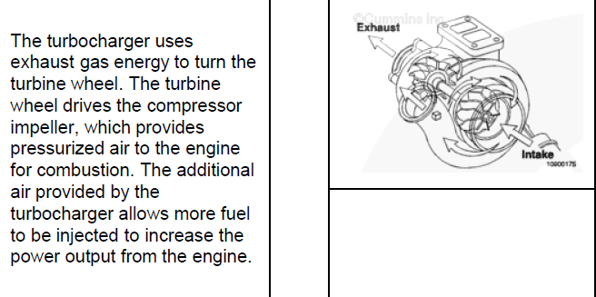
2006 Cummins ISB Turbocharger Operation
Source: Cummins Quickserve
Notes:
Discuss:
Differences between Cummins and Detroit Turbocharger
Uniqueness of VGT design

Slide 11
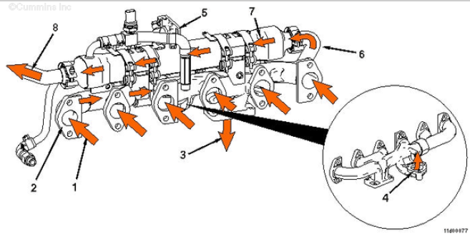
2006 Cummins ISB Exhaust System Flow
Exhaust gas to manifold
Exhaust manifold
Exhaust gas to turbocharger
Exhaust gas to EGR valve
EGR valve
Exhaust gas from EGR valve to EGR cooler connection
EGR cooler
Cooled exhaust gas to EGR connection tube and EGR mixer
Source: Cummins Quickserve
Notes:
Emphasize role of EGR valve and EGR cooler. Explain and discuss overall operation and connection to intake system

Slide 12
Notes on Other Engines
There are Detroit Diesels at UTA with similar EGR/Crankcase ventilation operations
There are also other similar Cummins engines, this model is used as a representative sample
Later model engines with DPF w/DOC or DEF w/ SCR approaches will be discussed on Days 2 and 3 of training
Notes:
Will demonstrate DDDL later in the day.
Emphasize that while Cummins will take the majority of class time, the troubleshooting concepts learned can apply to any engine now or in the future.
Depending on location of students in class, adjust time spent to represent the engines they have the most of.

Slide 13
EGR / Crankcase Ventilation Systems Service

Slide 14
Emissions System Service
EGR Cleaning procedures
Cleaning out Delta-p sensor
EGR Valve
EGR Cooler
EGR Pipes
Notes:
Ask if there are other procedures they would like to go over?
Have so far included detailed procedures in power point for EGR valve and EGR cooler.

Slide 15
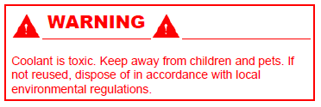
EGR Valve Service (1)
Before starting, disconnect and remove the following:
Electrical connectors from the EGR valve
Drain the coolant (procedure 008-018)
EGR valve coolant supply lines (011-030)
Exhaust pressure sensor tube (011-027)
Source: Cummins Quickserve
Notes:
More detail is on Quickserve, and will be in the student guide

Slide 16
EGR Valve Service (2)
Remove
Remove the V-band clamp that connects the EGR cooler connection tube to the EGR valve.
Remove the four capscrews, gasket, and EGR valve from the exhaust manifold.
Discard the gasket.
Source: Cummins Quickserve
Notes:
More detail is on Quickserve, and will be in the student guide

Slide 17
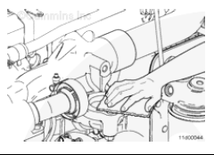
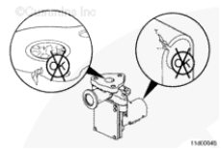
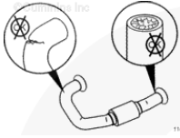
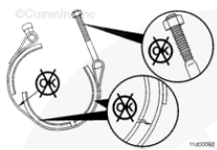
EGR Valve Service (3)
Clean and inspect for reuse
Clean the EGR valve marmon flange and the mounting surfaces of the EGR valve with a Scotch-BriteTM pad.
Clean the exhaust manifold with a Scotch-BriteTM pad.
Inspect the EGR valve for cracks, leaks, corrosion, restriction, and debris.
Inspect the exhaust transfer tube for cracks, corrosion and plugging.
Inspect the V-band clamps for signs of overextension,. The band must not be bent or damaged. Inspect the V-band clamp threads for damage. Replace the V-band clamp if damage is found.
1
2
3
4
5
Source: Cummins Quickserve
Notes:
More detail is on Quickserve, and will be in the student guide

Slide 18
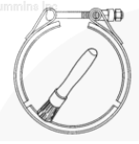
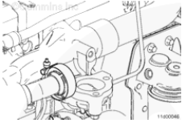
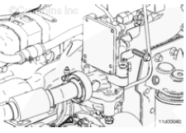
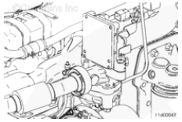
EGR Valve Service (4)
Installation
Before installing the V-band clamp, coat the clamping surface with high temperature anti-seize compound.
Position the V-band clamp and new gasket onto the exhaust transfer tube.
Position the EGR valve and new mounting gasket. Hold the EGR valve and gasket in place with the four mounting capscrews. Do not tighten the capscrews at this time.
Position the exhaust transfer tube V-band connection on the EGR valve. Tighten the V-band clamp to 11 nm [100in-lb]. Tighten the three upper vertical EGR mounting capscrews to 43 nm. [32 ft-lb]. Tighten the upper horizontal EGR mounting capscrews to 43 nm. [32 ft-lb]
1
2
3
4
Source: Cummins Quickserve
Notes:
More detail is on Quickserve, and will be in the student guide

Slide 19
EGR Valve Service (5)
Finishing Steps
Install and connect the following:
Exhaust pressure sensor tube (procedure 011-027)
EGR valve coolant supply and return lines (procedure 011-030)
Electrical connectors to the EGR valve
Fill the engine cooling system. (008-018)
Operate the engine and check for exhaust leaks
2
Source: Cummins Quickserve
Notes:
More detail is on Quickserve, and will be in the student guide

Slide 20
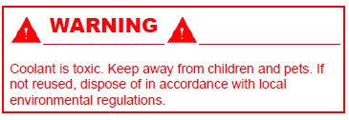
EGR Cooler Service (Preparation)
Before starting:
Drain the engine coolant (procedure 008-018)
Remove:
Exhaust pressure sensor tube (011-027)
EGR cooler coolant supply lines (011-030)
EGR cooler connection (011-024)
EGR connection tube (011-025)
EGR valve coolant return line (011-030)
Source: Cummins Quickserve
Notes:
More detail is on Quickserve, and will be in the student guide

Slide 21
EGR Cooler Service (Removal)
NOTE: it is not necessary to remove the brackets and clamping straps.
Remove the two capscrews that hold the EGR cooler and bracket assembly to the cylinder head
Remove the EGR cooler as an assembly
Source: Cummins Quickserve
Notes:
REMOVE

Slide 22
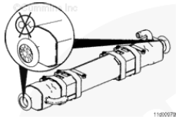
EGR Cooler Service (Clean and Inspect)
Use safety solvent to clean the soot from the inside of the EGR cooler.
Use compressed air to dry the inside of the EGR cooler.
If any solvents of cleaners entered the coolant side of the EGR cooler, use fresh water to flush the coolant side.
Inspect the cooler for debris and plugging.
Source: Cummins Quickserve
Notes:
CLEAN AND INSPECT FOR REUSE

Slide 23
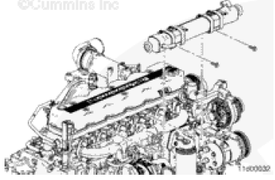
EGR Cooler Service (Install)
Install the cooler and bracket assembly to the cylinder head, use two capscrews.
Tighten the capscrews. Torque value: 33 nm. (24 ft-lb)
Source: Cummins Quickserve

Slide 24
EGR Cooler Service (Finishing)
After Installation of the assembly:
Install:
EGR valve coolant return line (011-030)
EGR cooler connection tube (011-024)
EGR connection tube (011-025)
EGR cooler coolant supply lines (011-030)
Exhaust pressure sensor tube (011-027)
Fill the engine coolant (procedure 008-018)
Source: Cummins Quickserve
Notes:
More detail is on Quickserve, and will be in the student guide

Slide 25
Other Service procedures
Exhaust gas pressure sensor tube
EGR Valve coolant lines
EGR cooler coolant lines
Do these cover the other topics listed in the lesson plan? Are there other procedures that need to be discussed?
Notes:
More detail is on Quickserve, and will be in the student guide

Slide 26
EGR / Crankcase Ventilation Systems Troubleshooting
Notes:
Note – Cummins Service manuals have section on Troubleshooting Symptoms, and another section on Troubleshooting Codes. This PowerPoint includes a few important troubleshooting trees for symptoms. We will explore various codes when we hook up INSITE on a bus. Always remember you can use INSITE to refer to all of these troubleshooting trees.

Slide 27
EGR / Crankcase Ventilation Problems
Intake Manifold pressure (boost) low
Intake Air Temp above spec
Turbocharger leaks engine oil or fuel
What other common or difficult problems do you see on these and similar engines? How have you addressed them?
Notes:
Lead a general discussion. Symptoms vs. Codes

Slide 28
Intake Manifold Pressure (Boost) Low
Step | Cause to Check | Correction
1 | Air intake or exhaust leaks | Inspect the air intake and exhaust systems for air leaks. (Procedure 010-024)
2 | Air intake system restriction is above specification | Check the air intake system for restriction. Clean or replace the air filter and inlet piping as necessary. (Procedure 010-031)
3 | Charge air cooler is restricted or leaking | Inspect the charge air cooler for air restrictions or leaks. (Procedure 010-027)
4 | Electronic fault codes active or high counts of inactive fault codes | Refer to Troubleshooting manual for fault code troubleshooting
5 | Intake manifold pressure sensor is malfunctioning | Check the intake manifold pressure sensor. (Procedure 019-159 in the Troubleshooting manual)
6 | Air compressor connection is loose or damaged | Check the connection between the manifold and the air compressor. Repair or replace if necessary.
7 | Exhaust system restriction is not within specification | Check the exhaust system for restrictions. (Procedure 011-009)
8 | Turbocharger wastegate is damaged or is stuck open | Check the wastegate for freedom of movement. Inspect the wastegate for damage. (Procedure 010-050)
9 | Turbocharger is not correct | Check the turbocharger part number and compare it to the control parts list, bulletin 3379133 or 4031327. Replace the turbocharger if necessary. (Procedure 010-033)
10 | Turbocharger is worn or damaged | Check the turbocharger for damage. Measure the turbine and compressor wheel clearances. (Procedure 010-033)
11 | Engine power output is low | Refer to the Engine Power Output Low symptom tree
Source: Cummins Quickserve
Notes:
More detail is on Quickserve, and will be in the student guide

Slide 29
Intake Air Temp Above Spec
Step | Cause to Check | Correction
1 | Fan drive belt is broken | Check the fan drive belt. Replace the belt if necessary. (Procedure 008-002)
2 | Fan drive belt is loose. | Check the belt tension and tighten if necessary. (Procedure 008-002)
3 | Cold weather radiator cover or winterfront is closed | Open the cold weather radiator cover or the winterfront. Follow OEM instructions
4 | Radiator shutters are not opening completely or the shutterstat setting is wrong | Inspect the radiator shutters. Repair or replace if necessary. Refer to OEM instructions. Check the shutter stat setting.
5 | Charge air cooler fins, radiator fins, or air conditioner condenser fins are damaged or obstructed with debris | Inspect the charge air cooler, air conditioner condenser, and radiator fins. Clean, if necessary. (procedure 010-027)
6 | Electronic fault codes are active or there are high counts of inactive fault codes. | View and troubleshoot the fault codes with INSITE.
7 | Intake manifold air temperature sensor has an in range failure | Check the intake manifold air temperature sensors that correspond to the fault code. Replace the sensor if necessary. (Procedure 019-159 in Troubleshooting manual)
8 | Programmable parameters or selected features are not correct. | Check the programmable parameters and the selected features with an electronic service tool. Set the parameters and features again if necessary. (Procedure 019-078 in Troubleshooting manual)
Source: Cummins Quickserve
Notes:
More detail is on Quickserve, and will be in the student guide

Slide 30
Intake Air Temp Above Spec (continued …)
Step | Cause to Check | Correction
9 | Fan drive or fan controls are malfunctioning. | Check the fan drive and controls. (Procedure 008-027) if electronically controlled by ECM. Otherwise see OEM service manual.
10 | Fan is not correct | Check the fan part number and compare it to the OEM specified part number. Replace fan if necessary
11 | Fan shroud is damaged or missing or the air recirculation baffles are damaged or missing | Inspect the shroud and the recirculation baffles. Repair, replace, or install if necessary. (Procedure 008-038)
12 | Vehicle speed is too low for adequate cooling with high engine load | Reduce the engine load. Increase the engine (fan) rpm by downshifting.
13 | Exhaust system leaking hot air into engine compartment | Check the exhaust plumbing for leaks or broken components. (Procedure 010-024)
14 | Incorrect / Excessive brake operation | Check exhaust brake operation and cooling fan operation. (Procedure 020-016 and/or manufacturers instructions)
15 | Intake manifold pressure (boost) sensor or circuit is malfunctioning | Check the boost sensor and circuit. Compare the intake manifold pressure sensor reading in the monitor mode using INSITE to a manual pressure gauge. (Procedure 019-059 in the Troubleshooting Manual)
16 | Vehicle cooling system is not adequate | Verify that the engine and vehicle cooling systems are using the correct components. Refer to OEM manual
17 | Fan is not an adequate size for the application | Verify that the fan is the correct size. Refer to the OEM manual.
Source: Cummins Quickserve
Notes:
More detail is on Quickserve, and will be in the student guide

Slide 31
Turbocharger Leaks Engine Oil or Fuel
Step | Cause to Check | Correction
1 | Engine is operating for extended periods under light or no-load conditions (slobbering) | Review the engine operating instructions in the Operations Manual. Low oil and coolant temperatures can be caused by long idle times (> 10 minutes). Shut off the engine rather than idle for long periods. If idle time is necessary, raise the engine / idle speed.
2 | White smoke is present | Refer to Smoke, white -- Excessive symptom tree
3 | Lubricating oil lines leak oil | Check all oil lines and fittings for leaks. Tighten loose fittings and replace leaking oil lines if necessary.
4 | Turbocharger oil drain line is restricted. | Remove the turbocharger oil drain line and check for restriction. Clean or replace the oil drain line. (Procedure 010-045)
5 | Crankcase ventilation system is plugged | Check and clean the crankcase breather and vent tube. (Procedure 003-002 or 003-018)
6 | Lubricating oil or fuel is entering the turbocharger | Remove the intake and exhaust piping, and check for oil or fuel
7 | Air intake system restriction is above specification | Check the air intake system for restriction. Clean or replace the air filter and inlet piping as necessary. (Procedure 010-031)
8 | Exhaust system restriction is not within specification | Check the exhaust system for restrictions. (Procedure 010-009)
9 | Turbocharger oil seal is leaking | Check the turbocharger compressor and turbine seals (Procedure 010-033)
10 | Turbocharger wheel clearance is out of specification | Check the radial bearing clearance and axial clearance. Inspect the turbocharger. Repair or replace turbocharger if necessary. (Procedure 010-033)
11 | Valve stem clearance is excessive or the valve stem seals are damaged | Check the valve stems and seals. (Procedure 002-004)
Source: Cummins Quickserve
Notes:
More detail is on Quickserve, and will be in the student guide

Slide 32
EGR / Crankcase Ventilation Systems Computer Diagnostics

Slide 33
Computer Diagnostic Systems
You will have much more success maintaining and troubleshooting Emission systems if you become comfortable using INSITE and DDDL
Valuable resource for manual references not just for finding codes
Provide an ability to examine a problem and easily test possible solutions
Use them early in the process
Notes:
Can also discuss here … Cummins / Detroit Field reps and techs, online forums, other resources available.

Slide 34
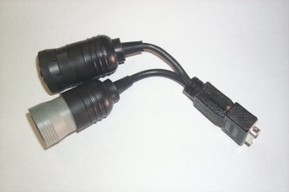
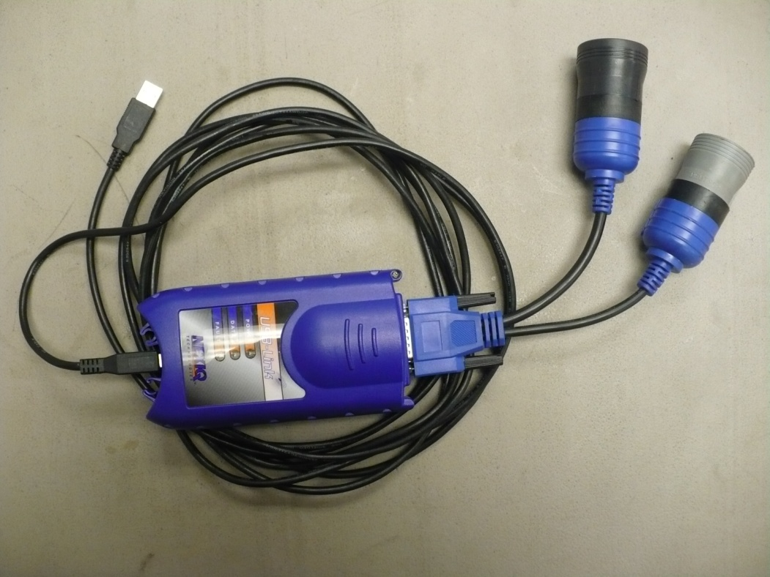
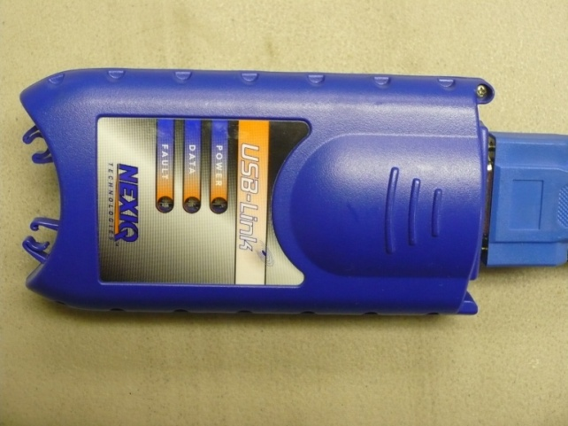
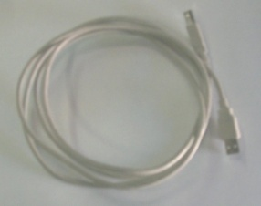
Cummins INSITE Introduction
Need 6/9 pin Deutsch cable, NEXIQ Technologies USB Link, USB Cable
Build connector: Assemble 6/9 pin serial connection to the end of DPA 4, and USB cable to other end of the Dearborn Group DPA 4 USB.
Notes:
Will have detailed instructions in student guide. Go down to a bus and demonstrate hook up if possible? Ask someone to demonstrate if they are already familiar?

Slide 35
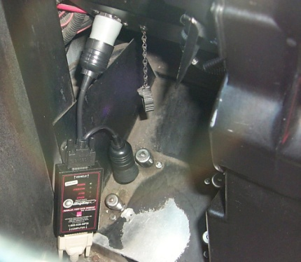
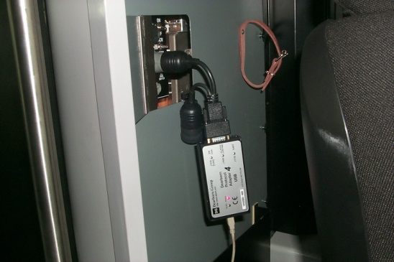
Cummins INSITE Introduction
Plug grey 6 pin Deutsh connector under dash of coach
Plug the USB cable into the port on the back of the computer
Gillig connection by driver’s left knee area
Optima is located behind driver’s seat on partition
Notes:
Where are VanHool and MCI hookups?

Slide 36
Cummins INSITE Introduction
Turn on the computer
Either
Turn the coach master switch to on position
Or turn the master switch on, start the coach, and continue
Double click this icon on the desktop:
Notes:
Will have detailed instructions in student guide. Go down to a bus and demonstrate hook up if possible?

Slide 37
Cummins INSITE Introduction
Select the appropriate adapter from the drop down list
Drop Down Menu
Notes:
Will have detailed instructions in student guide. Go down to a bus and demonstrate hook up if possible?

Slide 38
Cummins INSITE Introduction
From the menu bar at top of the screen select the Tools Menu.
From the Tools Menu, select Connect to ECM
Notes:
Will have detailed instructions in student guide. Go down to a bus and demonstrate hook up if possible?

Slide 39
Cummins INSITE Introduction
The Connect dialog box will pop-up, click the Connect button.
Notes:
Will have detailed instructions in student guide. Go down to a bus and demonstrate hook up if possible?

Slide 40
Cummins INSITE Introduction
A new work order window will open, click on cancel.
Notes:
Will have detailed instructions in student guide. Go down to a bus and demonstrate hook up if possible?

Slide 41
Cummins INSITE Introduction
Click on the Fault Codes button to display fault codes.
Notes:
Will have detailed instructions in student guide. Go down to a bus and demonstrate hook up if possible?

Slide 42
Cummins INSITE Introduction
Click on the Data Monitor button to open the data monitor.
Select the items you wish to view from the list and press the start button.
The button with the red circle will start recording data for future reference. (To view live data simply press the play button.) To stop a recording press the stop button.
Notes:
Will have detailed instructions in student guide. Go down to a bus and demonstrate hook up if possible?

Slide 43
Cummins INSITE Introduction
To perform tests press the ECM Diagnostic Tests button.
Select test from list and press start.
Notes:
Will have detailed instructions in student guide. Go down to a bus and demonstrate hook up if possible?

Slide 44
Cummins INSITE Introduction
Here is the screen for the cylinder cut-out test.
Notes:
Will have detailed instructions in student guide. Go down to a bus and demonstrate hook up if possible?

Slide 45
Cummins INSITE Introduction
Press Advanced ECM Data button for additional information available.
Notes:
Will have detailed instructions in student guide. Go down to a bus and demonstrate hook up if possible?

Slide 46
Cummins INSITE Introduction
Press Features and Parameters button to change system settings.
Notes:
Will have detailed instructions in student guide. Go down to a bus and demonstrate hook up if possible?

Slide 47
Cummins INSITE Introduction
Press Trip information button to view fuel economy and other trip data.
Notes:
Will have detailed instructions in student guide. Go down to a bus and demonstrate hook up if possible?

Slide 48
Cummins INSITE Introduction
Press Trip information button to view fuel economy and other trip data.
Notes:
Will have detailed instructions in student guide. Go down to a bus and demonstrate hook up if possible?

Slide 49
DDDL Introduction
Need 6/9 pin Deutsch cable, NEXIQ Technologies USB Link, USB Cable
Build connector: Assemble 6/9 pin serial connection to the end of DPA 4, and USB cable to other end of the Dearborn Group DPA 4 USB.
Notes:
Will have detailed instructions in student guide. Go down to a bus and demonstrate hook up if possible? Ask someone to demonstrate if they are already familiar?

Slide 50
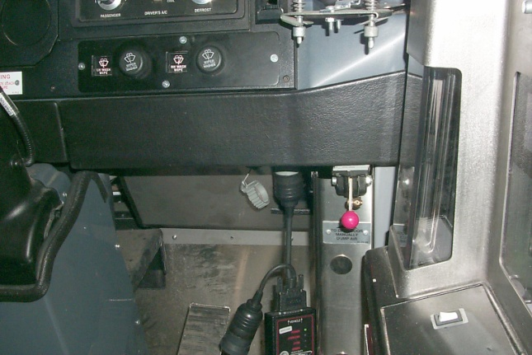
DDDL Introduction
Plug grey 6 pin Deutsh connector under dash of coach
Plug the USB cable into the port on the back of the computer
Gillig connection by driver’s left knee area
MCI is located by driver’s right knee area. (04000 use 6 pin grey connector, 05000 use 9 pin black connector)
Notes:
Where are VanHool and MCI hookups?

Slide 51
DDDL Introduction
Turn on the computer
Either
Turn the coach master switch to on position
Or turn the master switch on, start the coach, and continue
Double click this icon on the desktop:
Notes:
Will have detailed instructions in student guide. Go down to a bus and demonstrate hook up if possible?

Slide 52
Detroit Diesel Diagnostic Link Introduction
On the “Toolbar” there are two boxes indicating connection status and code status.
Tasks can be opened from the “Toolbar”, or the dialogue box
Notes:
Will have detailed instructions in student guide. Go down to a bus and demonstrate hook up if possible?

Slide 53
Detroit Diesel Diagnostic Link Introduction
On the “Toolbar” there are two boxes indicating connection status and code status.
Tasks can be opened from the “Toolbar”, or the dialogue box
Notes:
Will have detailed instructions in student guide. Go down to a bus and demonstrate hook up if possible?

Slide 54
Detroit Diesel Diagnostic Link Introduction
“Cylinder cutout” and other diagnostic tests can be accessed through the “Diagnostics” menu on the “Menu Bar”
Notes:
Will have detailed instructions in student guide. Go down to a bus and demonstrate hook up if possible?

Slide 55
Detroit Diesel Diagnostic Link Introduction
Clicking on the “Fault Codes” icon :
on the “Toolbar” will show both active and inactive codes
Notes:
Will have detailed instructions in student guide. Go down to a bus and demonstrate hook up if possible?

Slide 56
Detroit Diesel Diagnostic Link Introduction
To check or change injector calibrations, click on “Calibrations” on the “Menu bar”
Click on “Injector…”
Notes:
Will have detailed instructions in student guide. Go down to a bus and demonstrate hook up if possible?

Slide 57
EGR / Crankcase Ventilation Systems Hands-On Practice
Notes:
Give students opportunities to:
Use INSITE to demonstrate the diagnostic process.
Demonstrate the process of responding to an overtemp code, performing a test to watch EGR valves open and close
Click on various codes within INSITE. Demonstrate how to create a custom data list.
Continue to emphasize:
You will have much more success maintaining and troubleshooting Emission systems if you become comfortable using INSITE and DDDL
Valuable resource for manual references not just for finding codes
Provide an ability to examine a problem and easily test possible solutions
Use them early in the process

